Slide 1
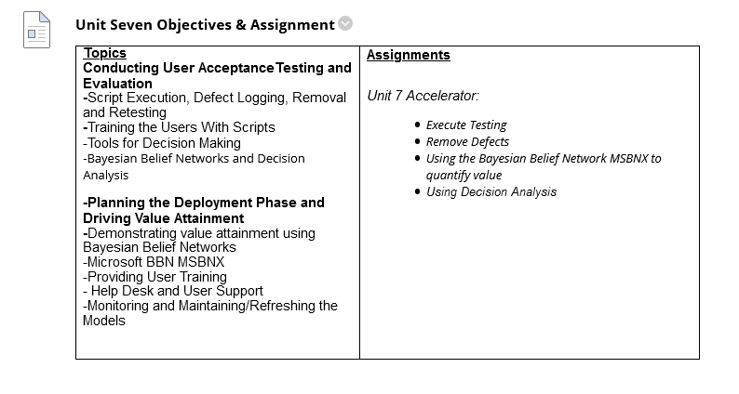

Slide 2
Observation From Homework
Biggest Issue was the tripwire metric. All input values need to be identical for both hypotheses.
Death and Case prediction models are generally stronger than rate prediction models. Population size is normally a strong covariate.
MARS appears to be the favorite linear engine.
Overall, mastery demonstrated.

Slide 3
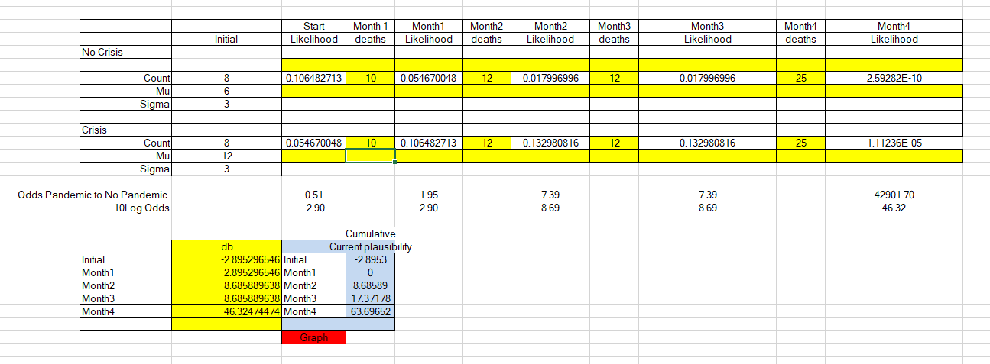

Slide 4
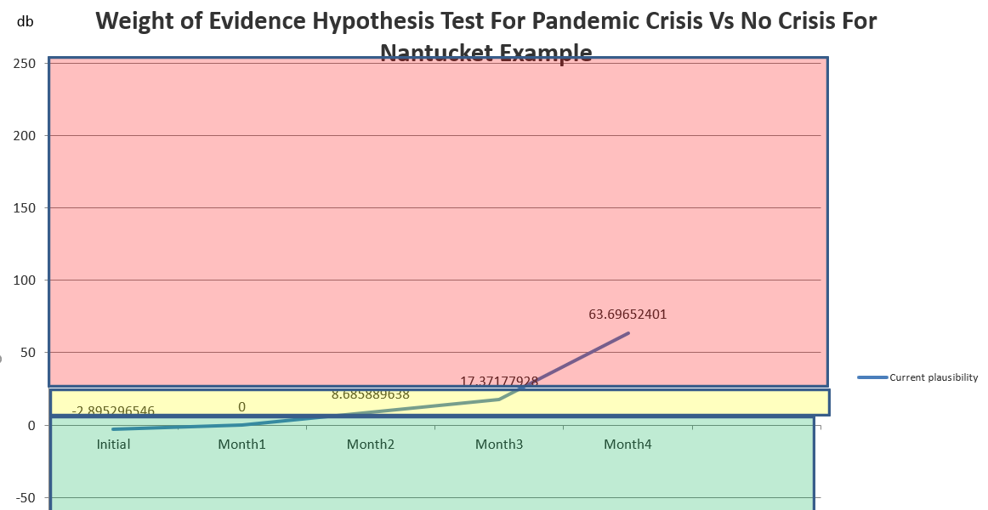

Slide 5
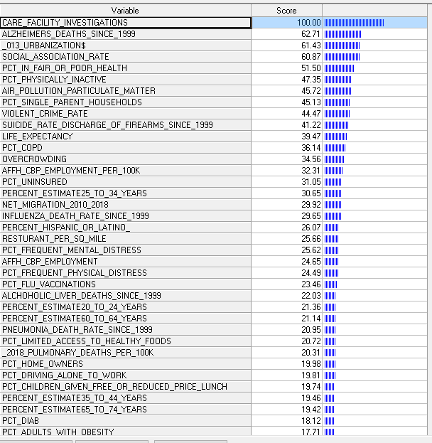
The Wisconsin Example:
Variable Importance Treenet

Slide 6
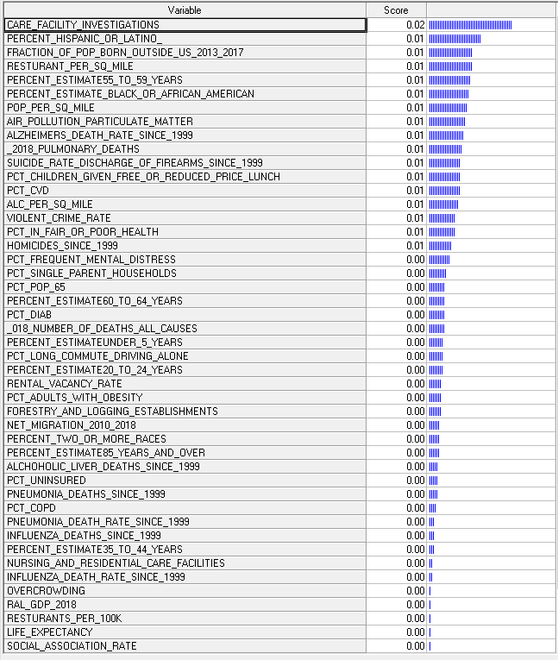
Variable Importance Random Forest
The Wisconsin Example:
Variable Importance Random Forest

Slide 7
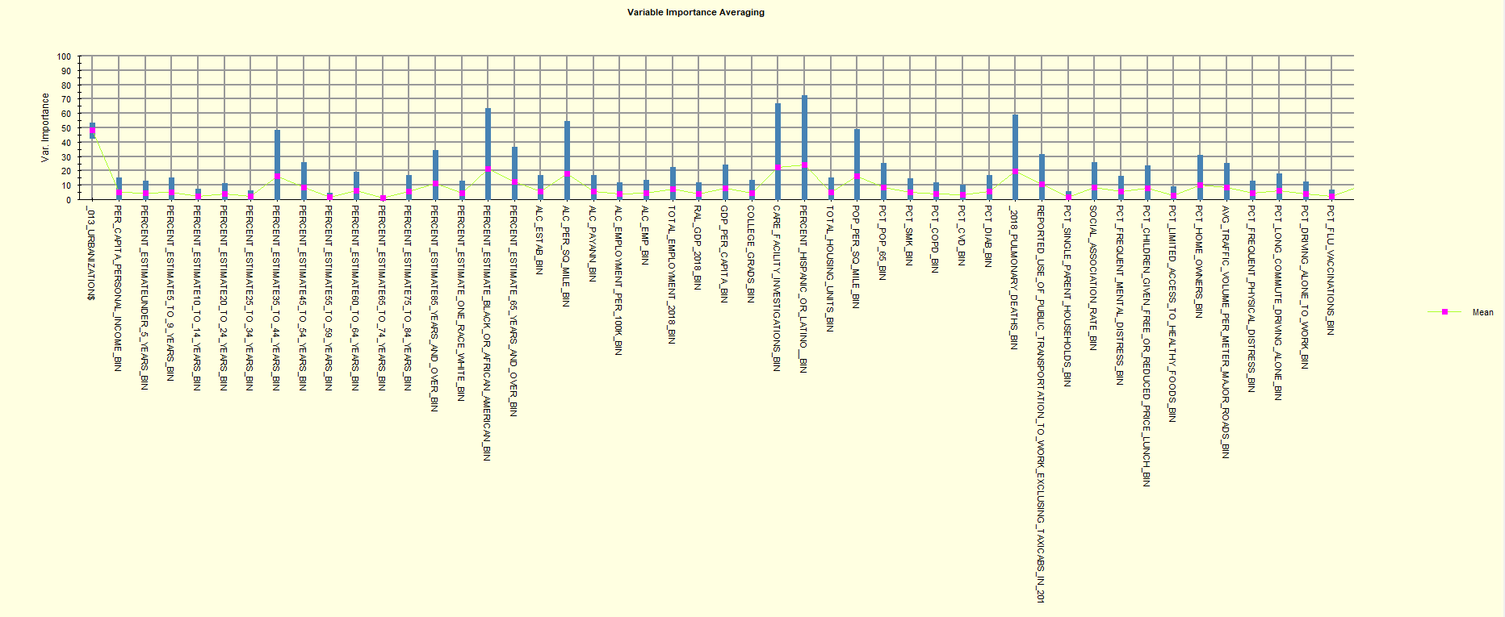
Variable Importance A Multi-Modeling Result

Slide 8
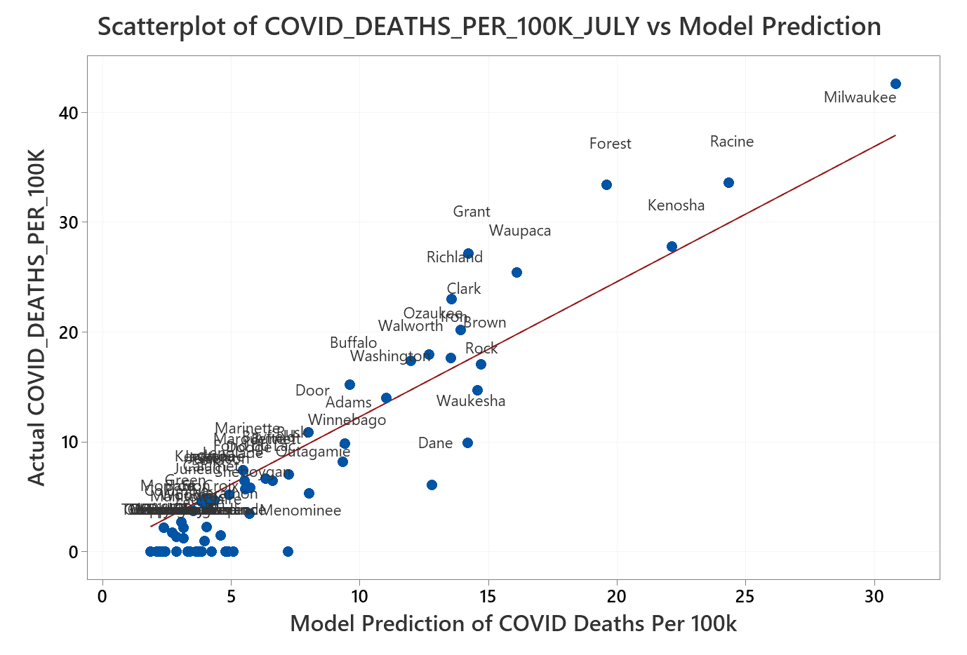
Random Forest Model Performance For Wisconsin Counties

Slide 9
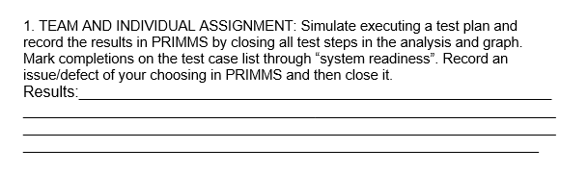

Slide 10
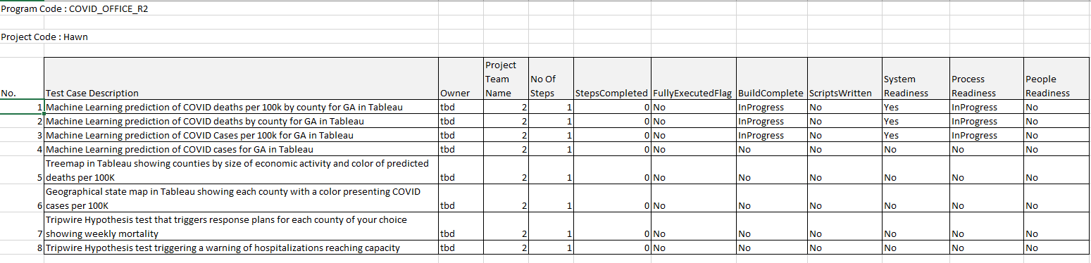
Testing and Validation Check List

Slide 11
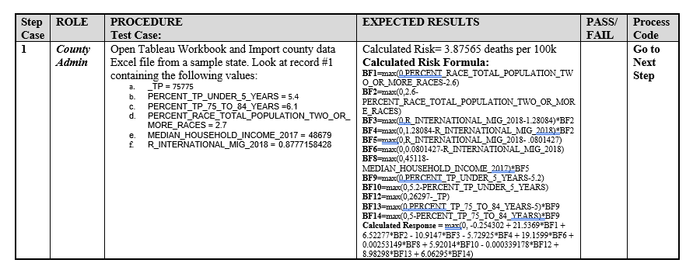
Sample UAT Test Script –From Tara
Testing Results Based Upon Tableau Calculated Result from Tableau

Slide 12
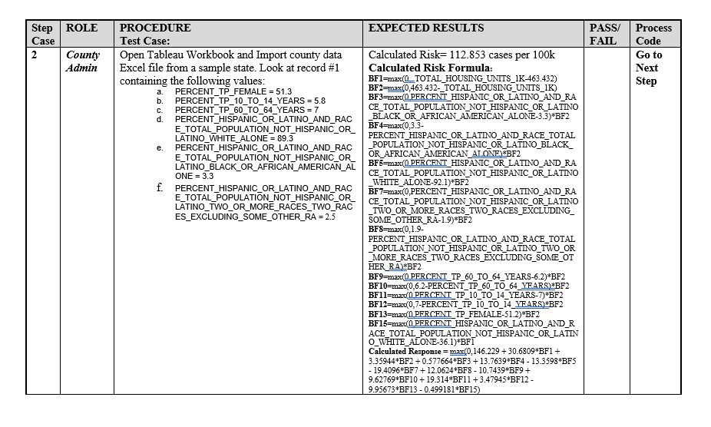
Sample UAT Test Script –From Tara

Slide 13
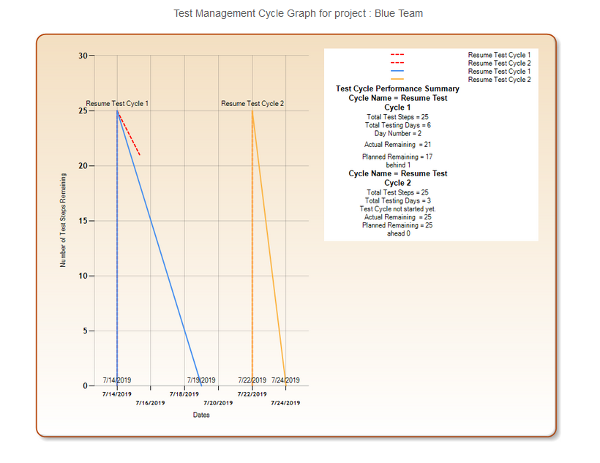

Slide 15
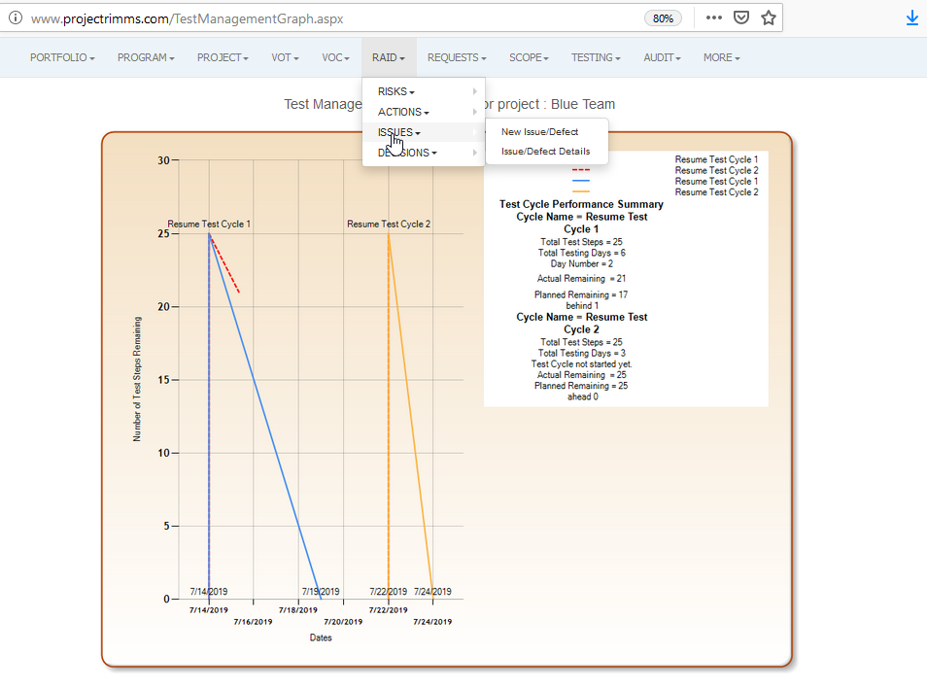

Slide 16
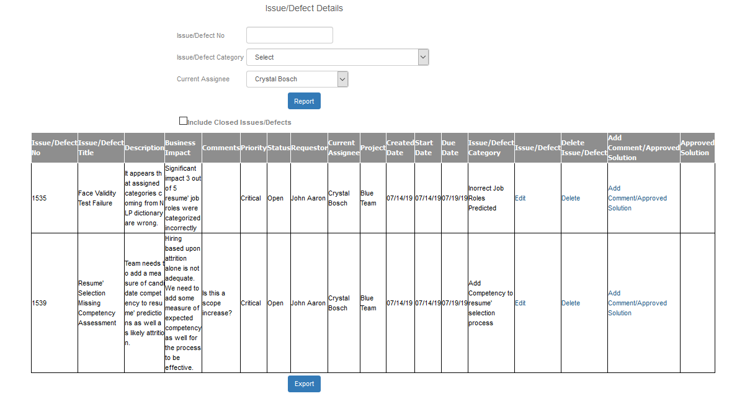

Slide 17
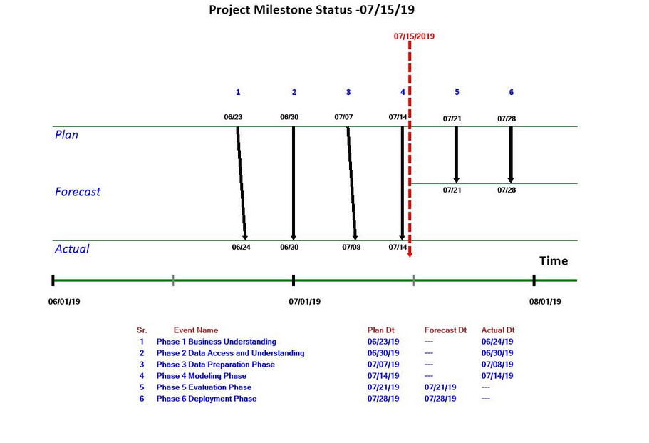
So now, the team is scheduled to complete two testing cycles (subject to quality criteria) by 7/21, but two big issues have emerged in testing.

Slide 18
While Cycle 1 testing continues, the team attempts to resolve the two problems.
An approach is needed for each.

Slide 19
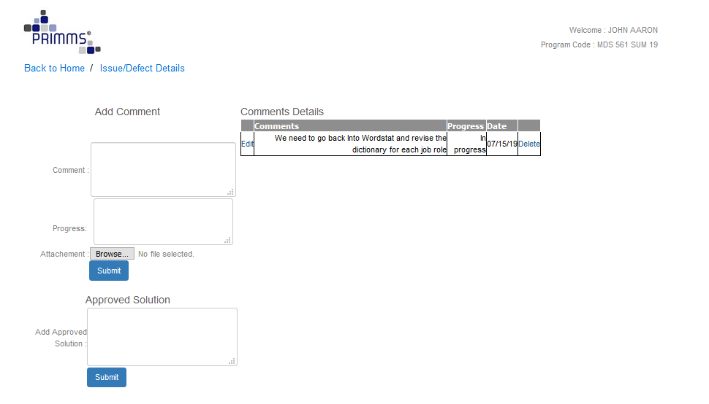

Slide 20
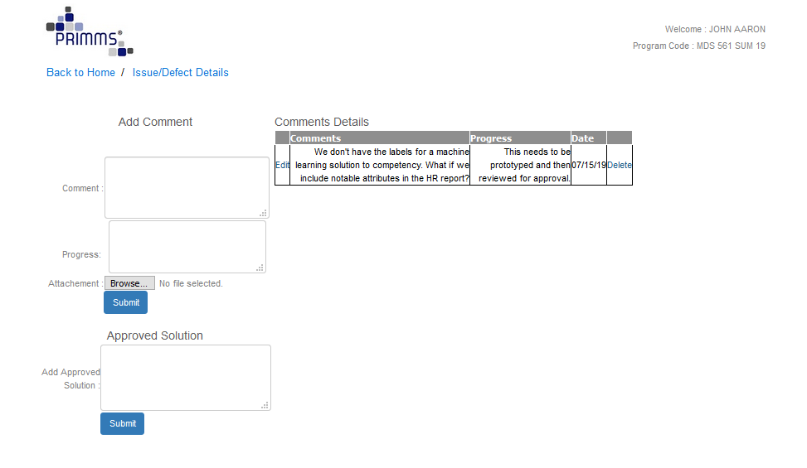

Slide 21
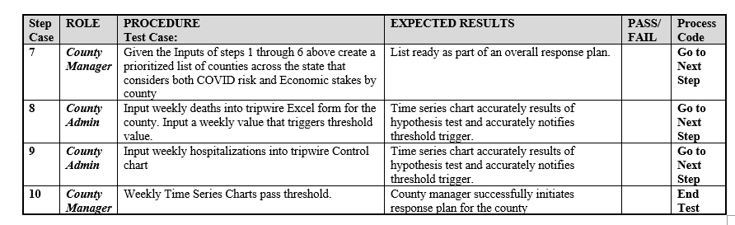
How Will Users Drive Value From The System?

Slide 22
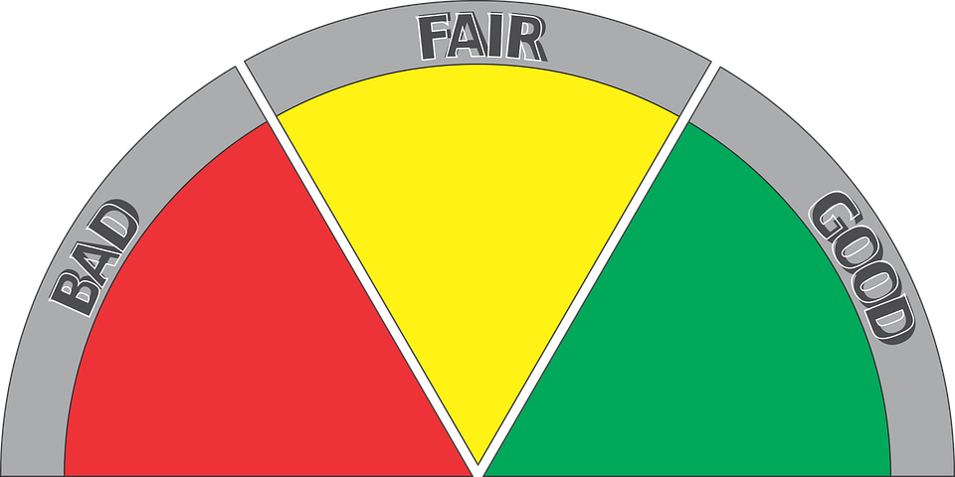
What Does Full Information Mean Within Our Context?
Where We Appear To Be
Informative
Where We Want To Be
Raw
Actionable

Slide 23
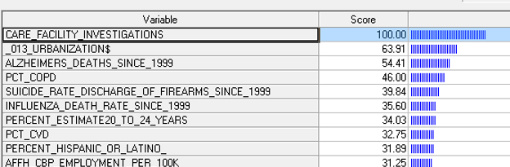
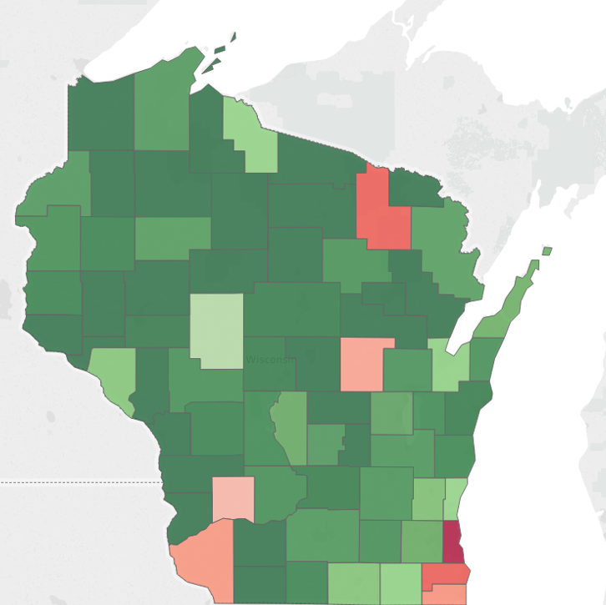
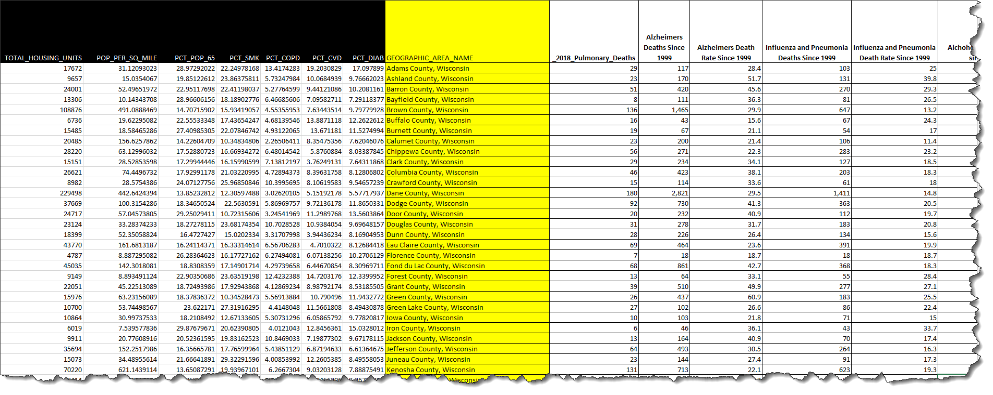
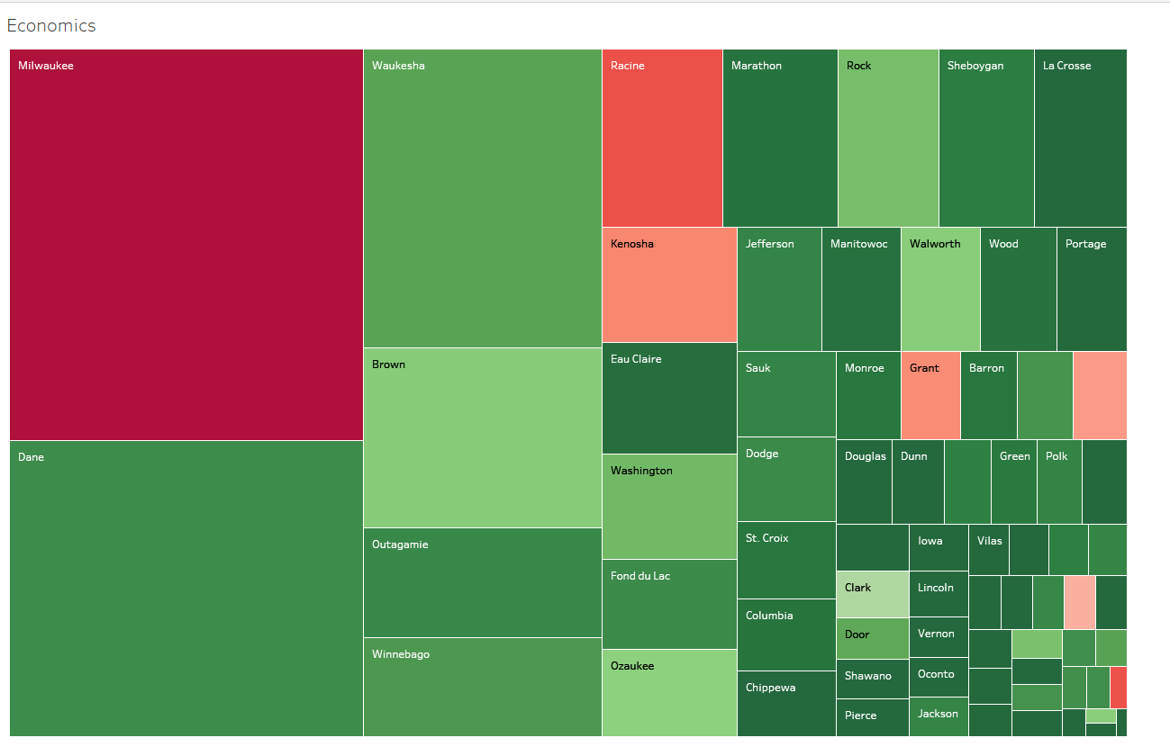
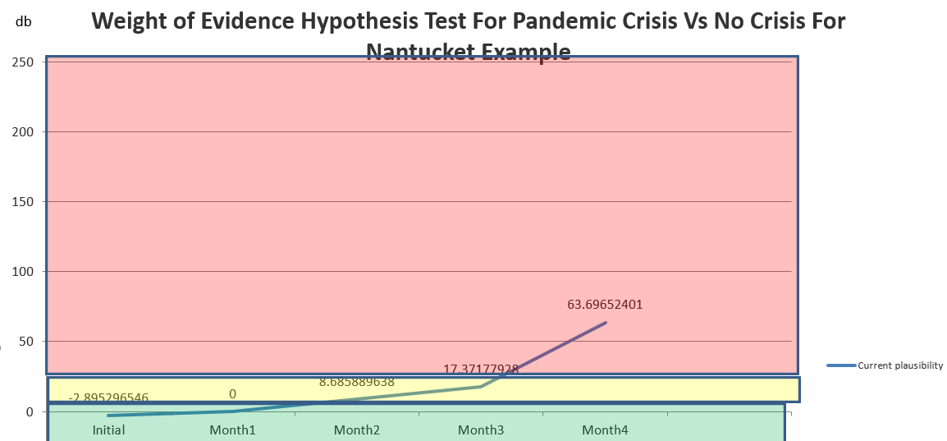
From Tools (Ex. Minitab SPM
Links to Comprehensive List of Data Sources for All Regions (Metro or County Level)
Export to Statistical/Machine Learning Tools (Ex. Minitab SPM)
Variable Importance
Criteria Thresholds
Predictions
Gestalt Understanding
Supported Hypotheses
Discarded Hypotheses
Minitab SPM
Map of Risk By County
Source 1
Source 2
Direction
Source 3
Join
Tableau or Power BI
Data Set
Decision
Analysis
(e.g. Open or Close County)
Treemap of Economic Stakes By County by Safety Risk
Source 4
Source 5
Hypotheses
Tripwire Hypothesis Tests
Histograms
Tables
Maps
Basic Statistics and Tabulations
Trend Graphs
Narratives
Etc
Source k

Slide 24
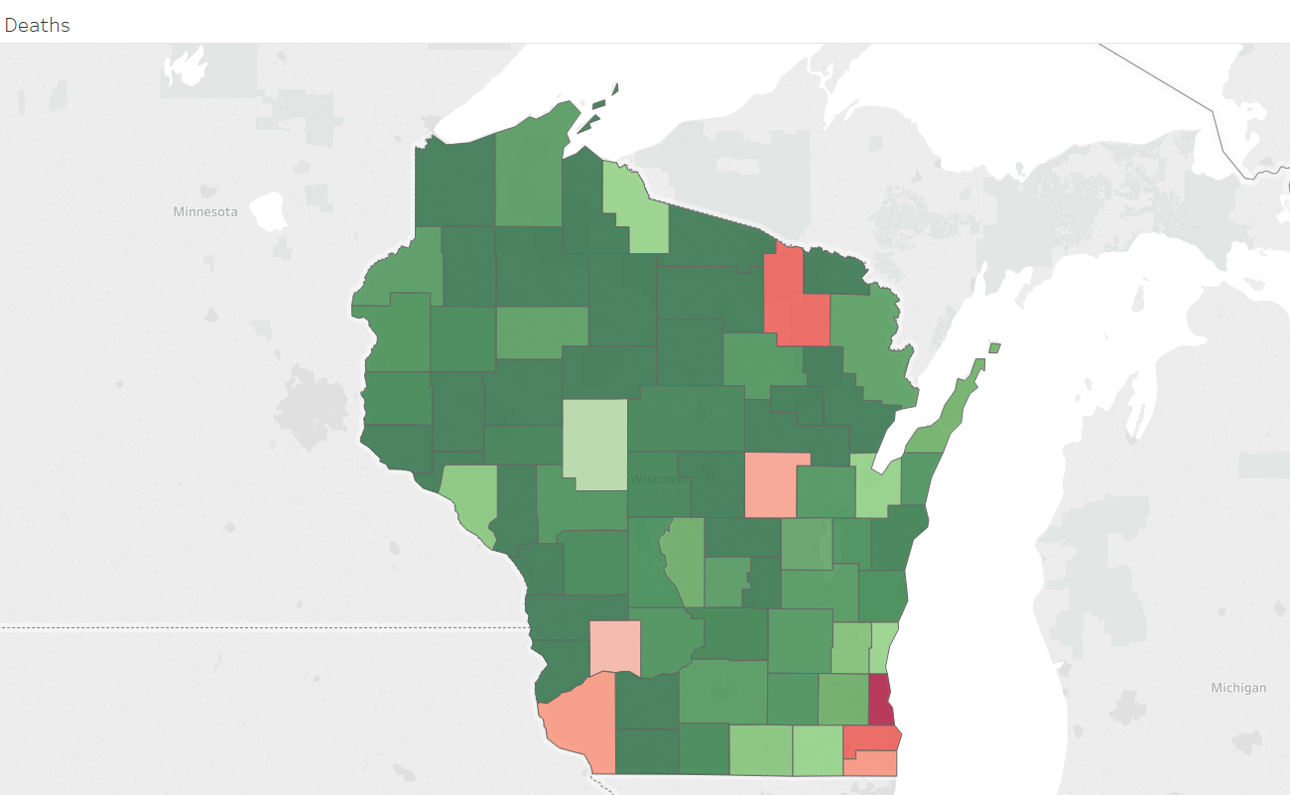

Slide 26
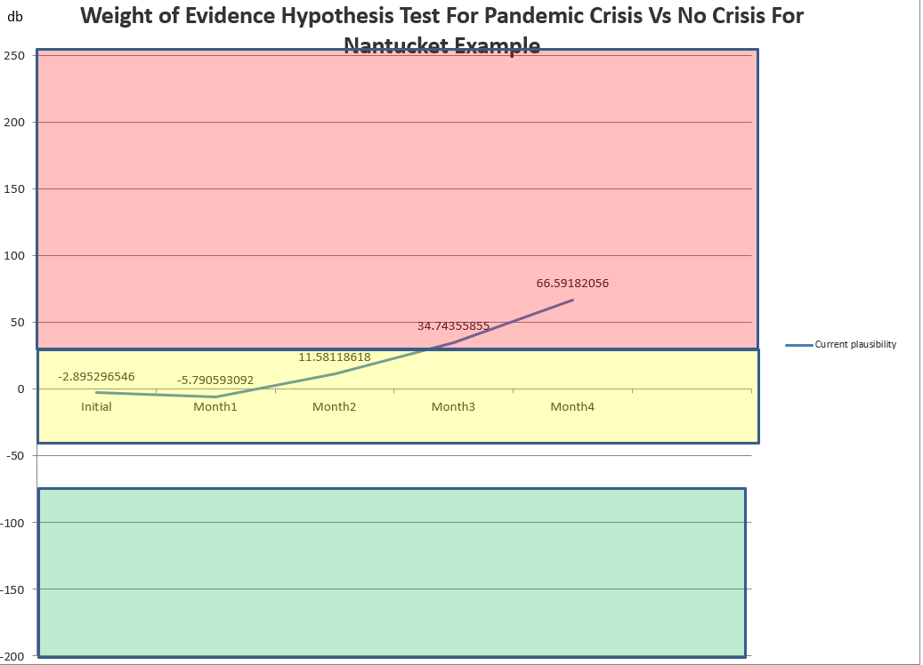

Slide 27
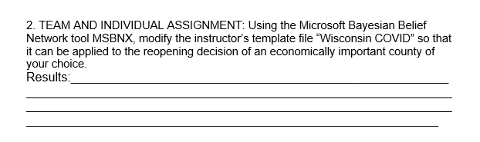

Slide 28
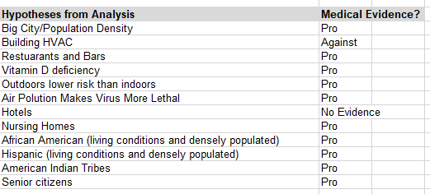
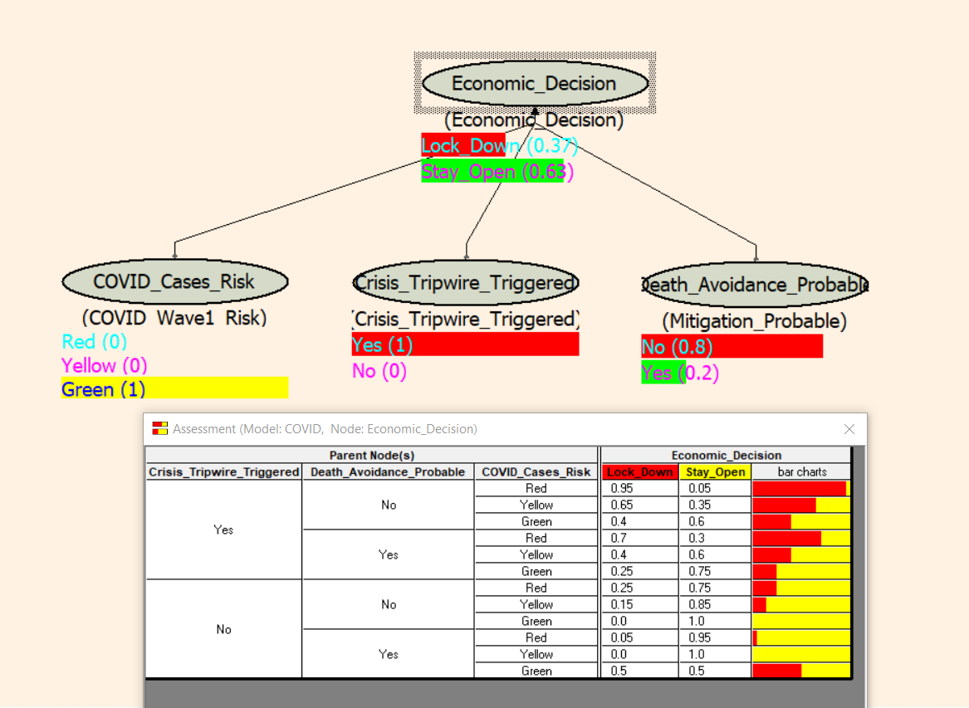
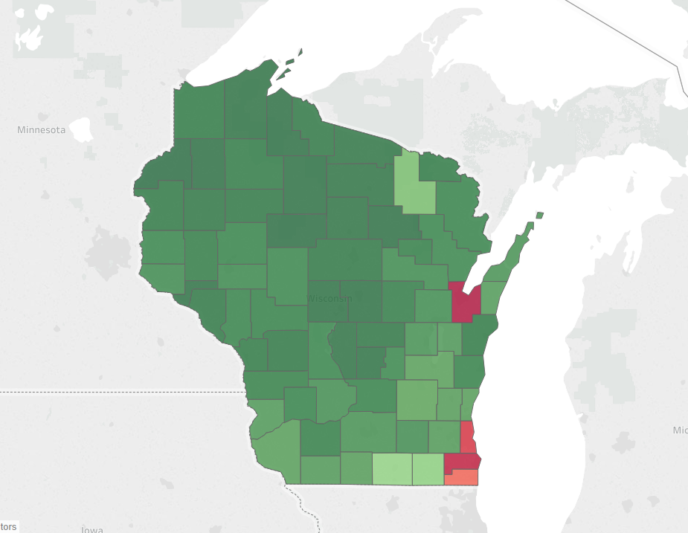
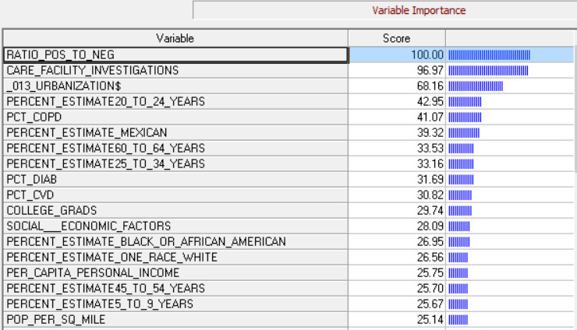
Bayesian Belief Network to Aid Decision Making—Dane County WI Example
Death Rate Drivers Controllable?

Slide 29
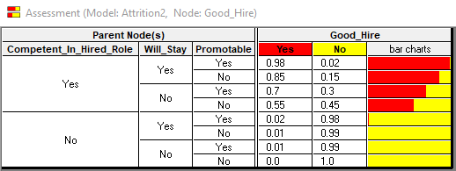
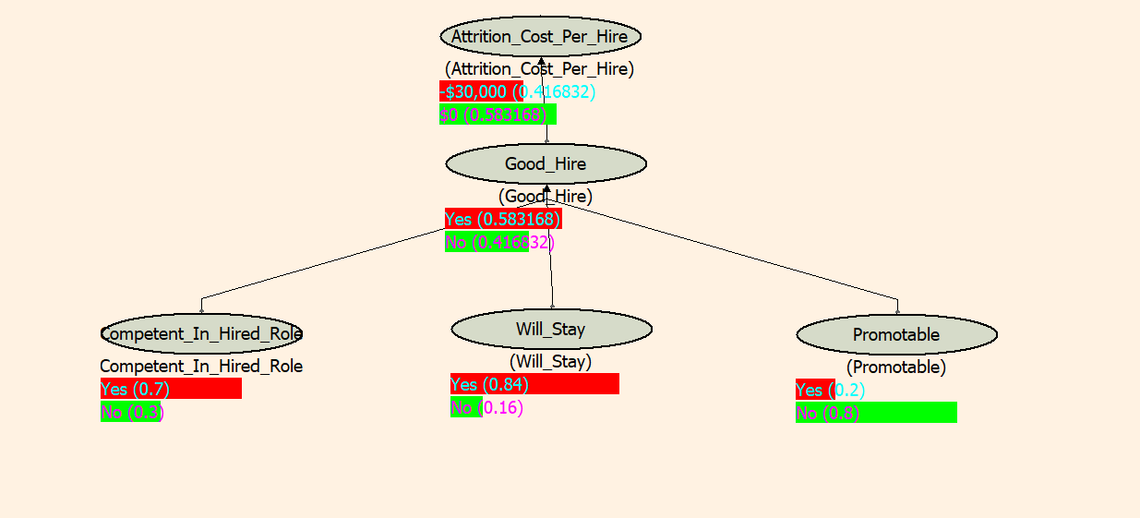
Bayesian Belief Networks Help Us Visualize the Value in Probabilistic Terms
If we have 10.7 new hires per month expected loss is $30k X 0.417 X 10.7= $ 134k
58% chance a good hire

Slide 30
The Bayesian Belief Network is a Compact Decision Tree
Good Hire
Competent
Will Stay
Promotable
Yes
0.98
Yes
0.876
P=0.2
Yes
0.826
P=0.84
P=0.8
No
0.85
yes
0.58
P=0.7
0.70
P=0.16
.58
P=0.2
No
P=0.8
0.55
.012
P=0.2
0.02
P=0.3
P=0.3
Yes
.01
P=0.84
P=0.8
No
0.01
P=0.2
0.01
P=0.16
.002
No
P=0.8
0.0
A Backward Pass Calculation From Our Example
Probability
of Good Hire

Slide 31
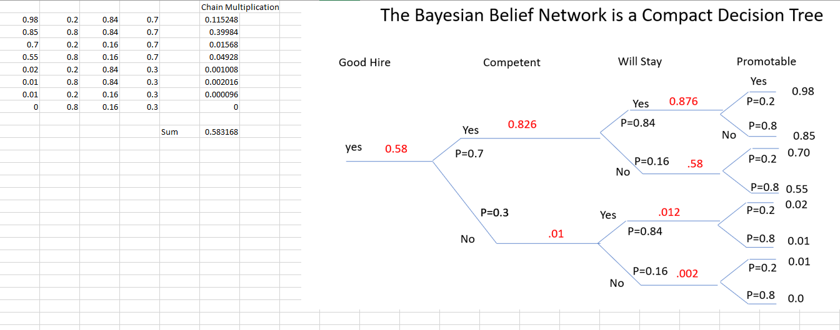

Slide 32
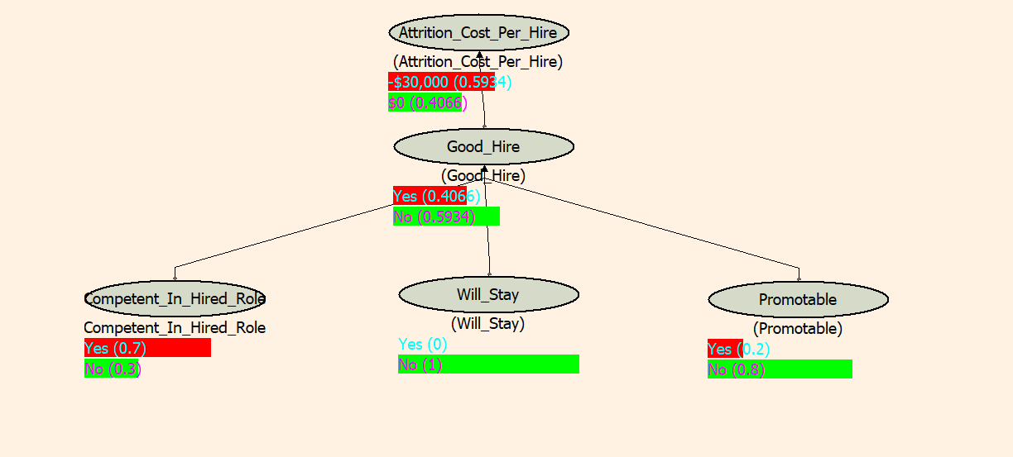
By Spotting People Who Would Leave (Assuming Average Competency and Promotability) Before Hiring, We Save $56k/mo.
$30k X 0.593 X 10.7= $ 190k
$30k X 0.417 X 10.7= $ 134k
40% chance a good hire
Potential Savings
$ 56k/month
If Machine Learning Predicts Will Leave Based Upon Evidence

Slide 33
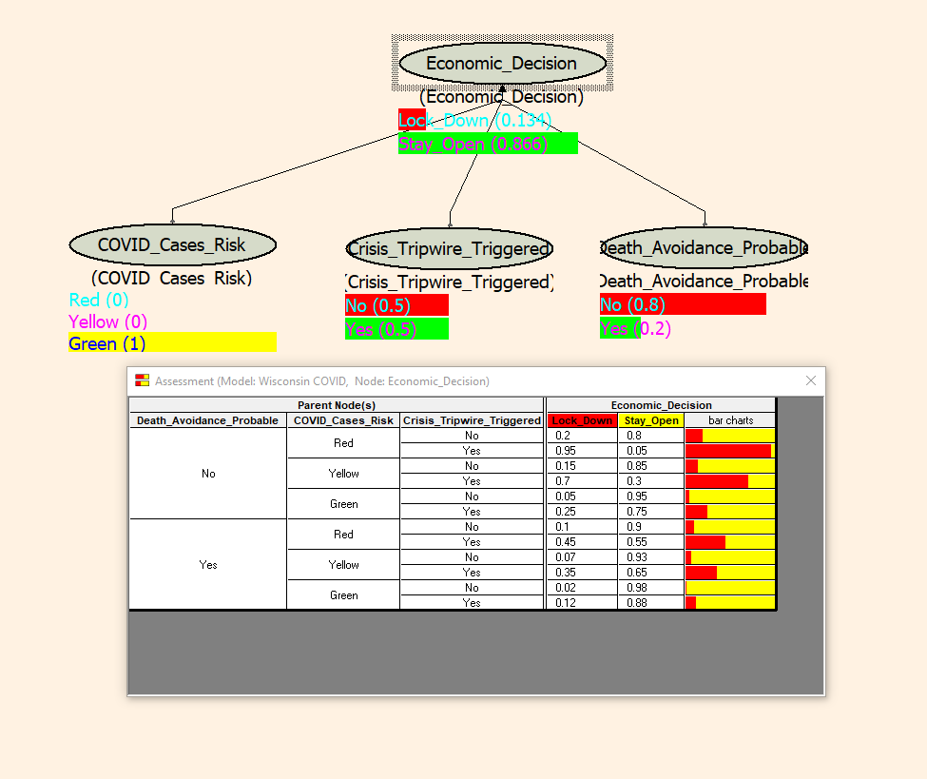

Slide 34
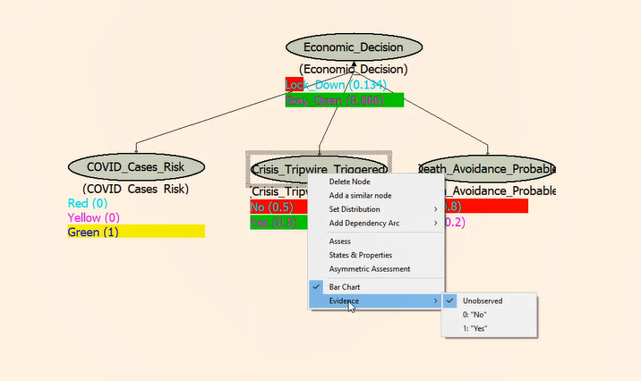

Slide 35
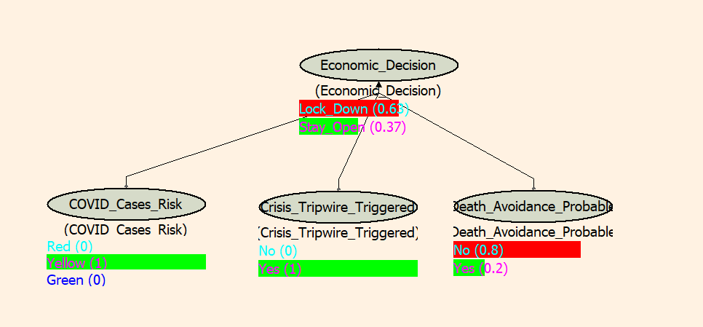

Slide 36
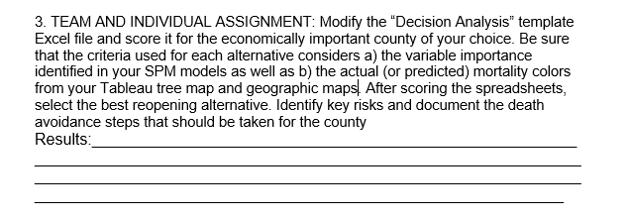

Slide 37
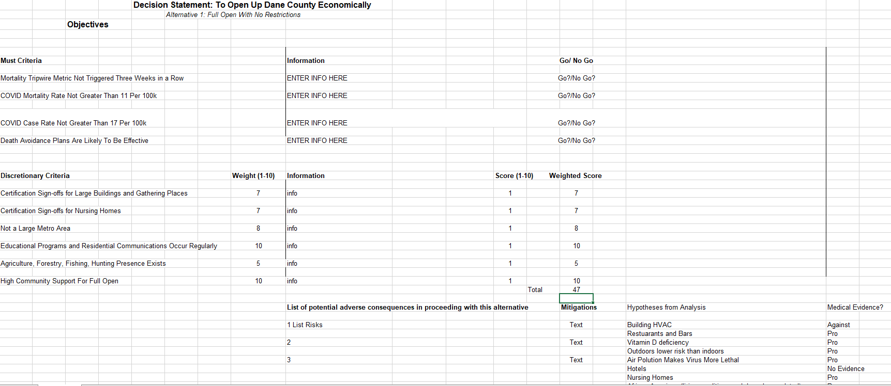
The Final Decision Is Made Through Decision Analysis

Slide 38
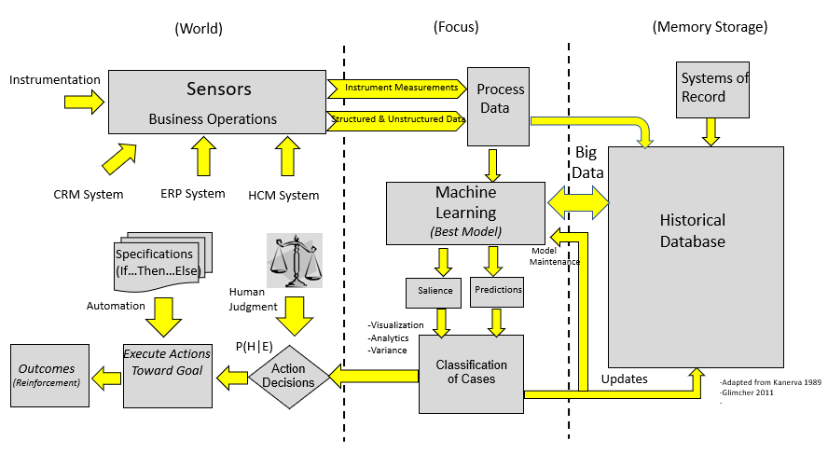
Perception-Action Cycle
A Block Diagram of a System of Intelligence For Enterprise Processes
The Complete Perception-Action Cycle of AI

Slide 39
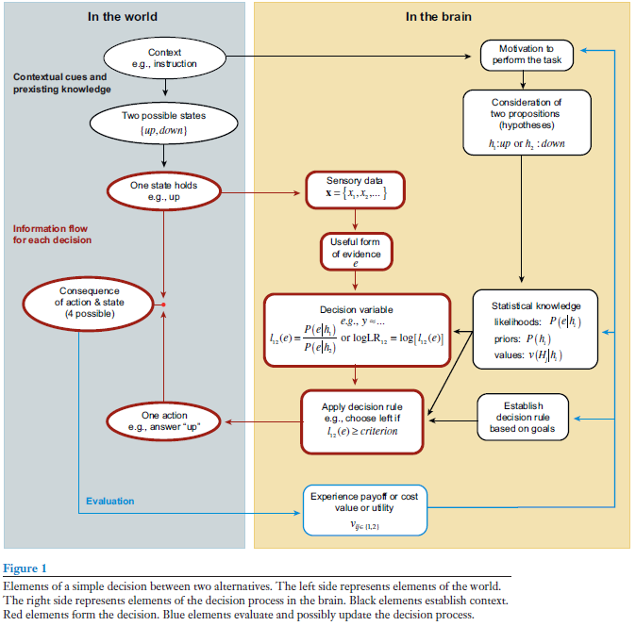


Neuro-Scientists such as Glimcher (2011) and Gold/Shadlen (2007).
AI Feedback Enables The User to Update His/Her Beliefs Rationally Following the Rules of Probability and Expected Value By Presenting Evidence Tied To History.

Slide 40
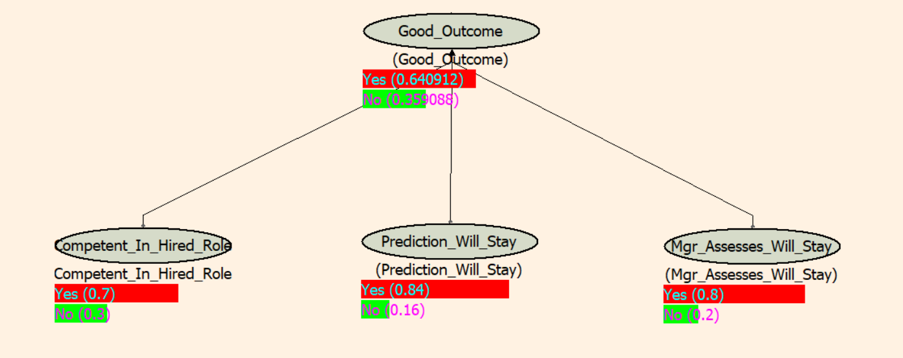
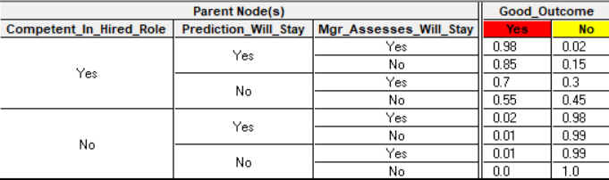
Updating Beliefs Given Evidence--- A Quick Illustration of Hiring an Employee
No Current Evidence—Just General History and Personal Judgment

Slide 41
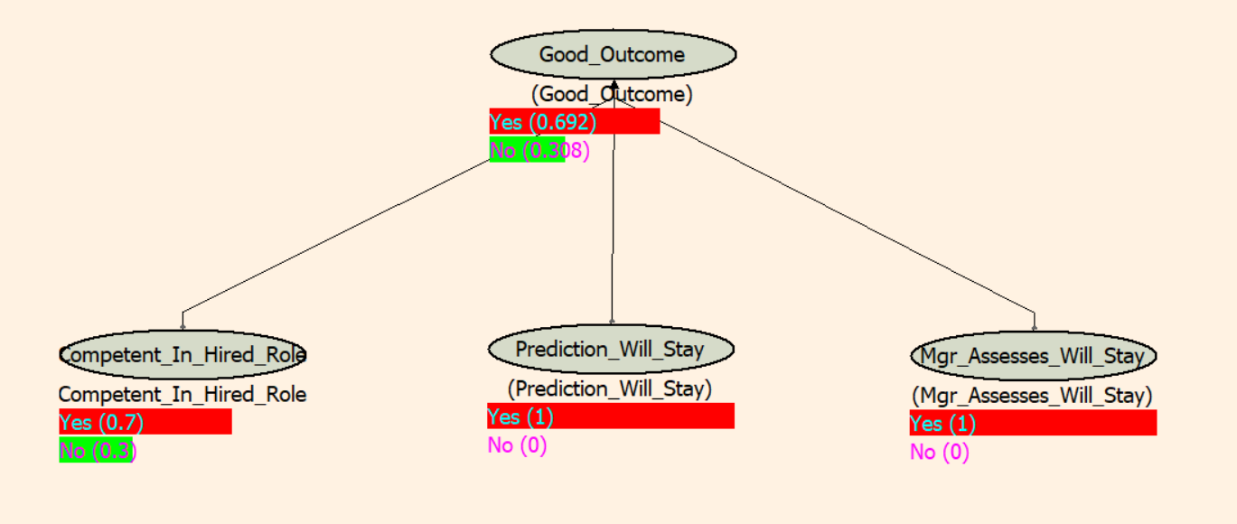
Updating Beliefs Given Evidence--- Continued
From Machine Learning Classification
Machine Learning Prediction and Managerial Interview Agree that Employee Will Stay

Slide 42
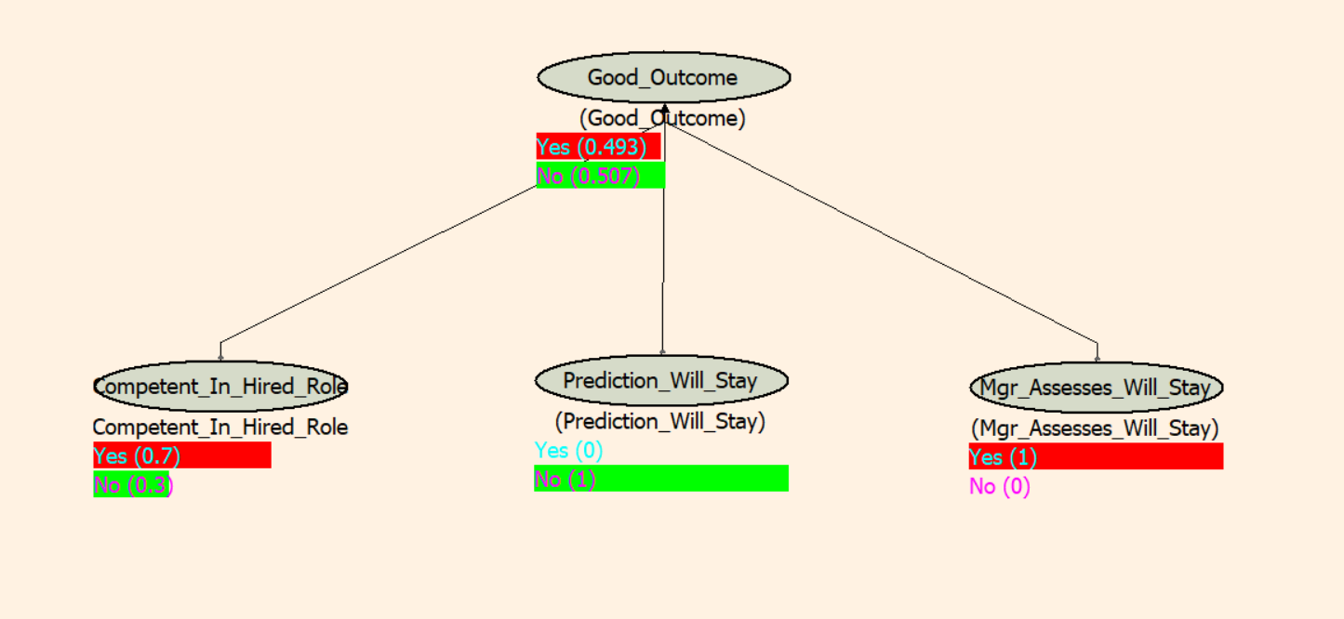
Updating Beliefs Given Evidence--- Continued
The Machine Learning Prediction Causes the Manager to Rethink About Hiring the Candidate
From Machine Learning Classification
The ML Prediction May Consider Many, Many Factors
Machine Learning Prediction and Managerial Interview Evidence Disagree

Slide 43
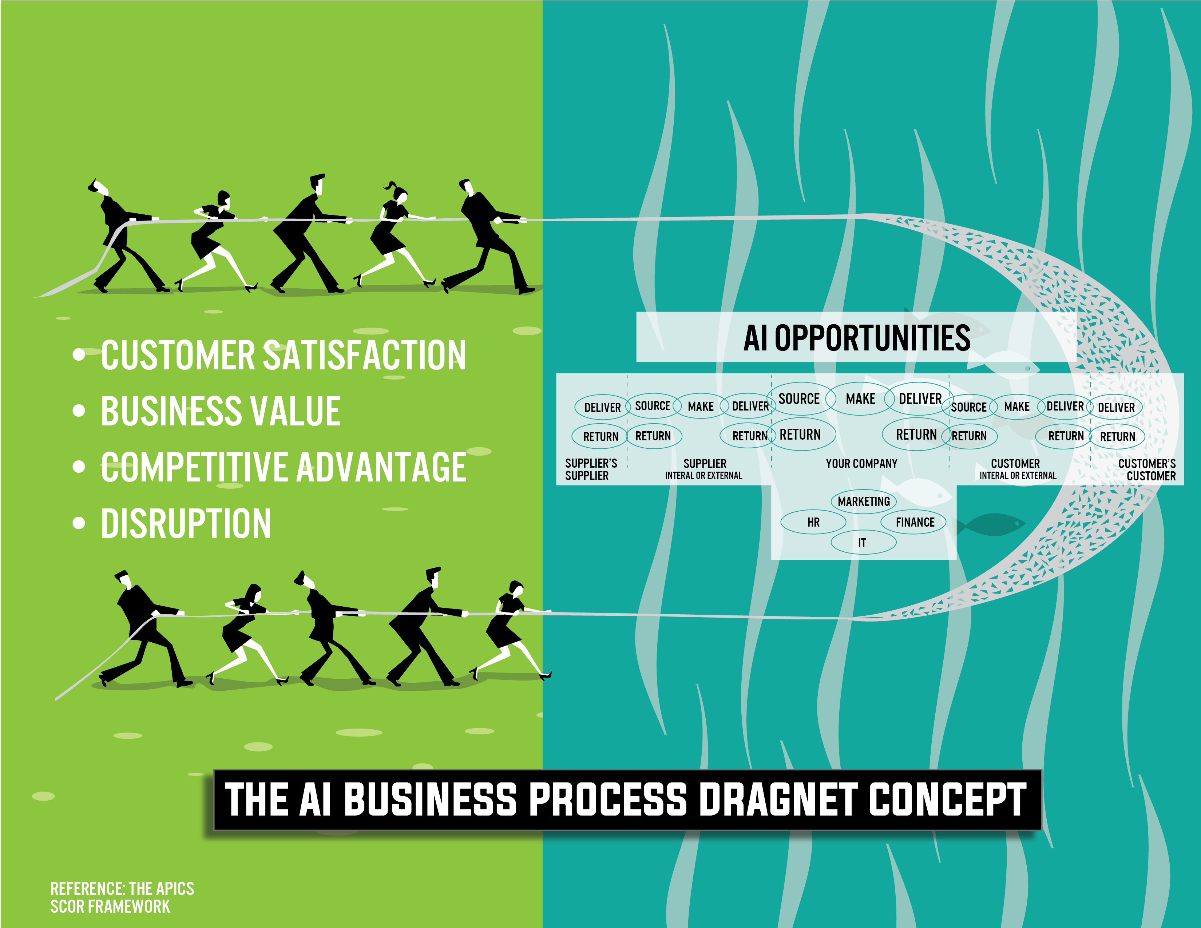

Slide 44
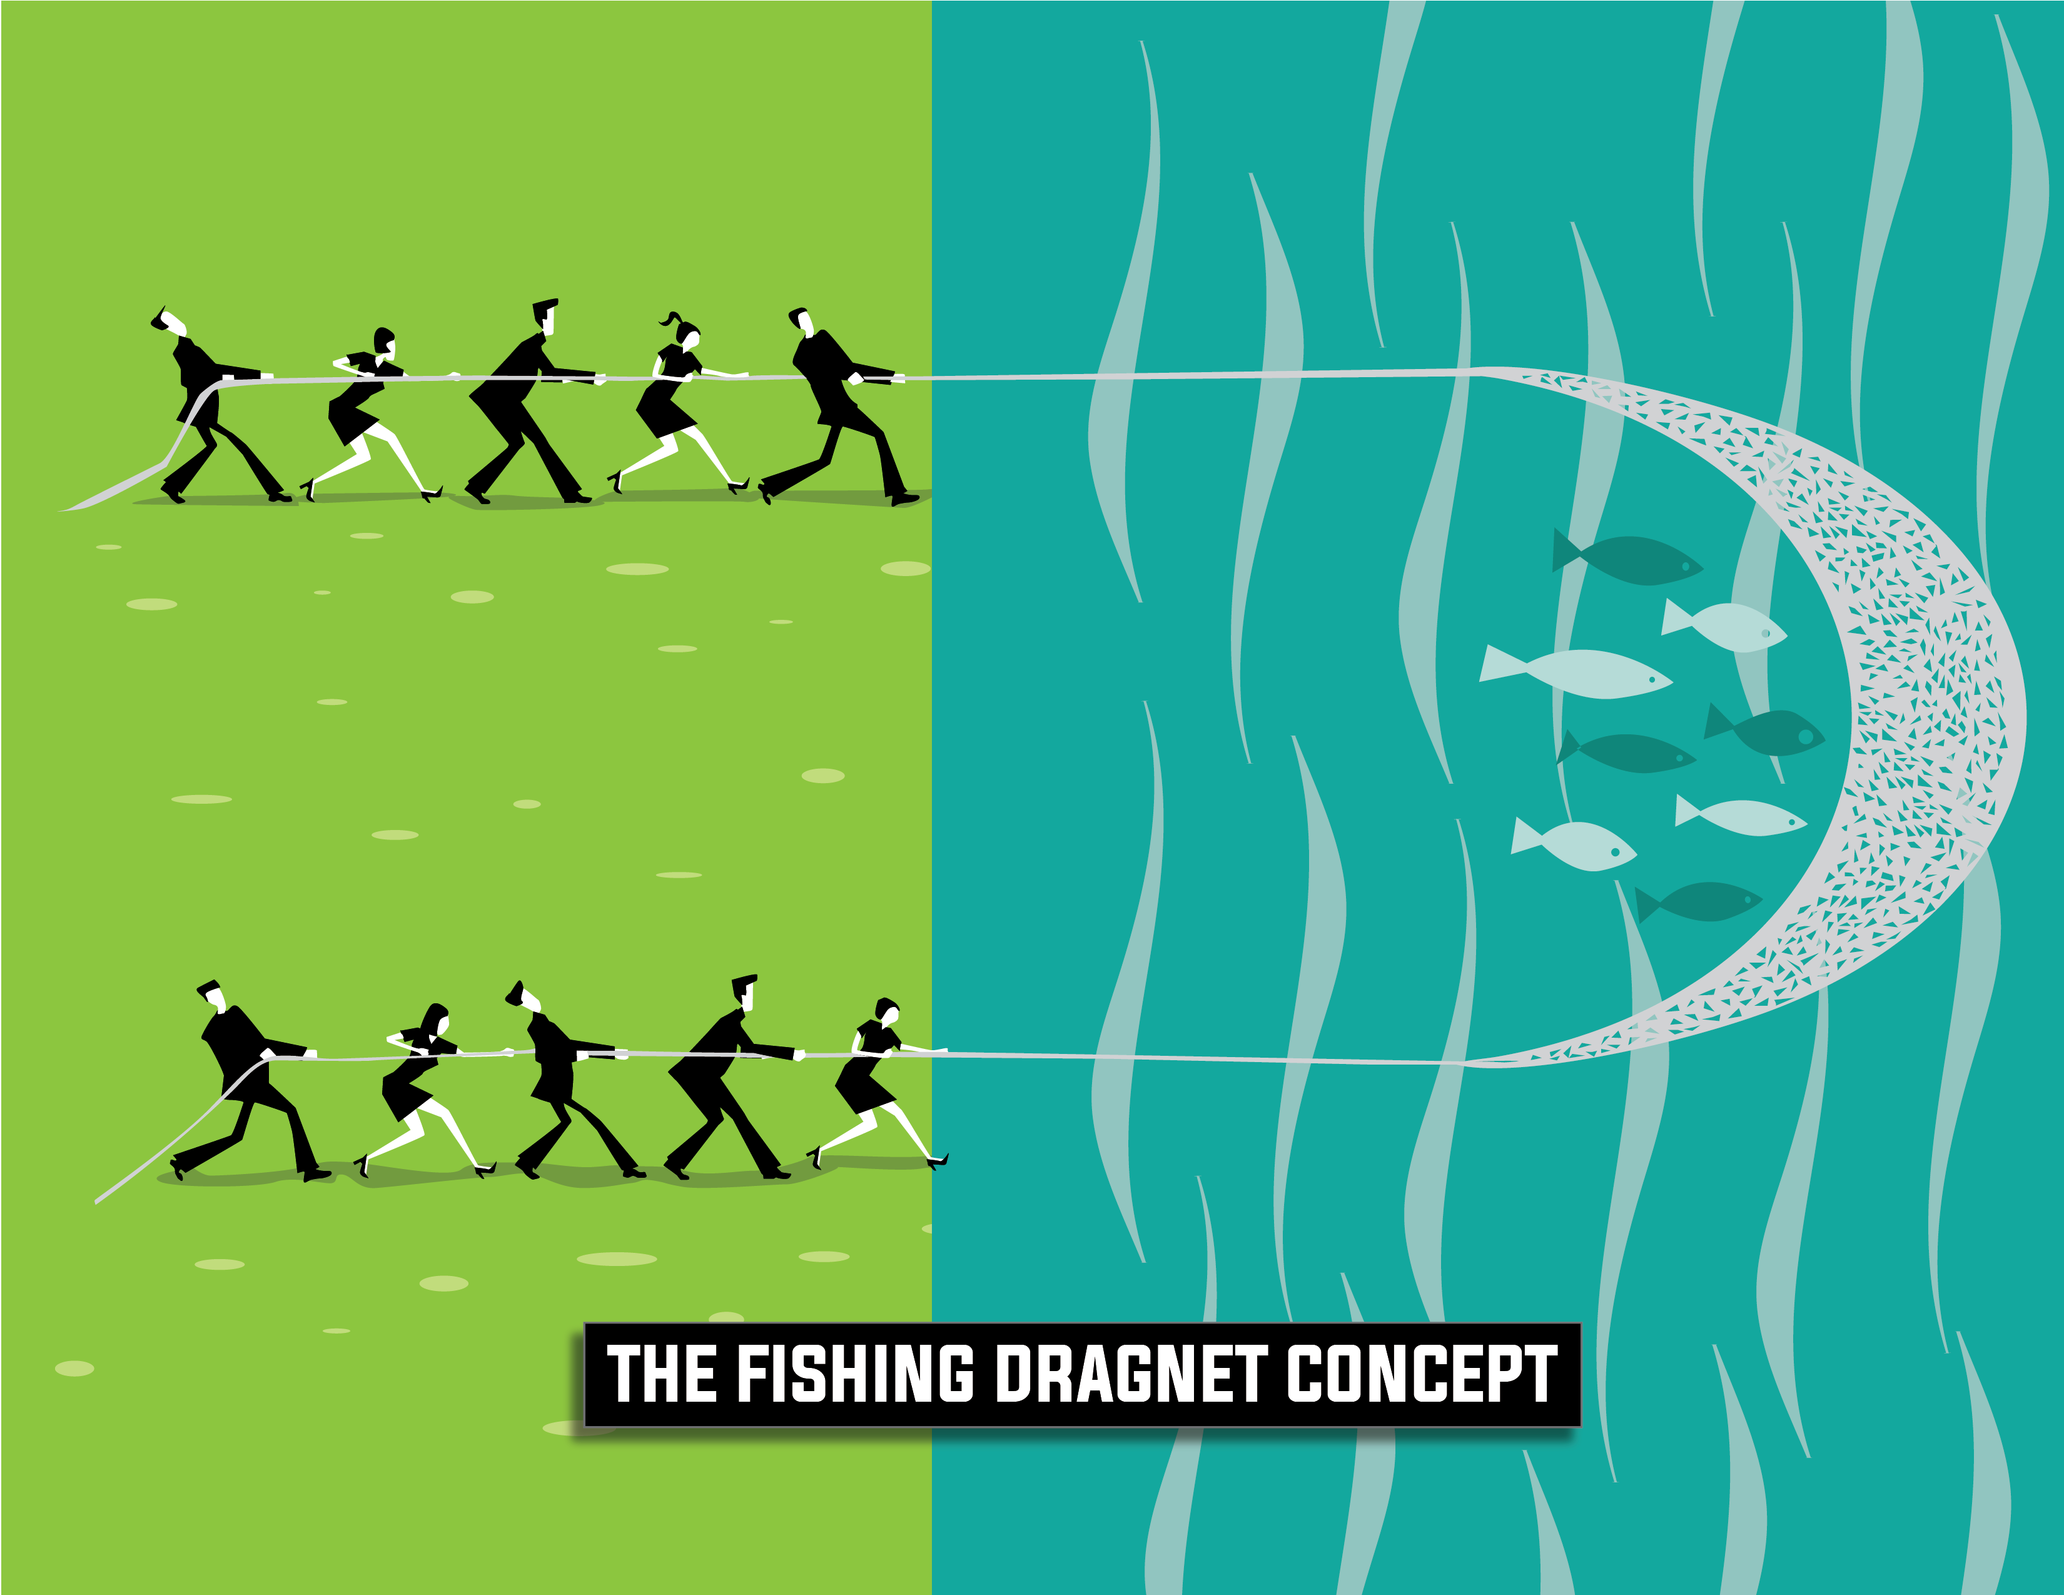
The Intake Process Begins With Management Communication

Slide 45
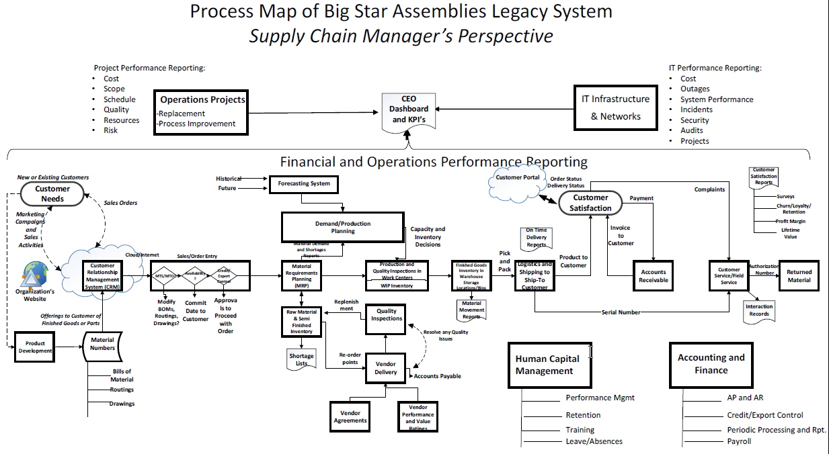

Slide 46
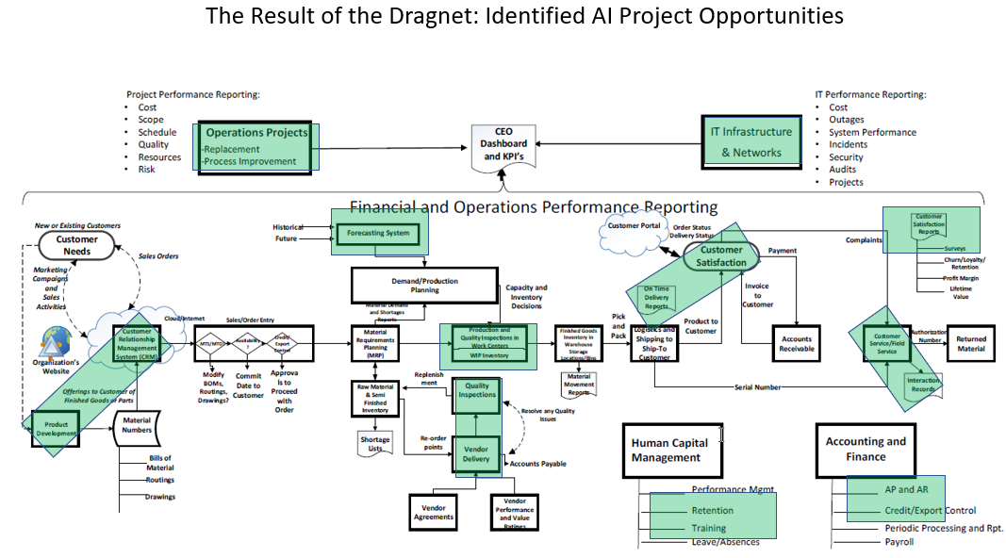

Slide 47


Slide 48


